Slide 1
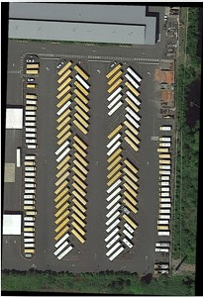
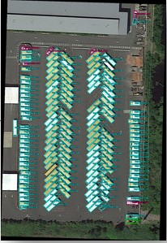
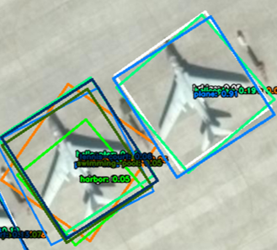
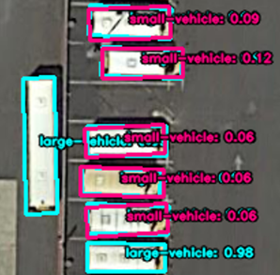
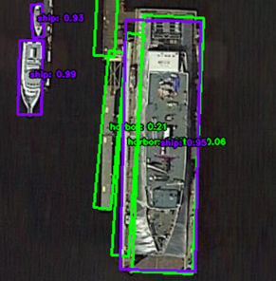
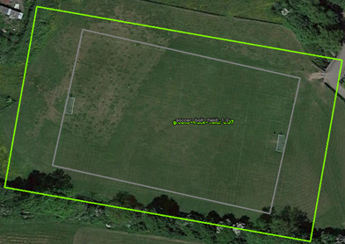
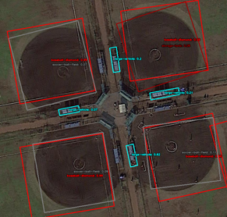
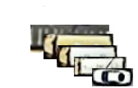
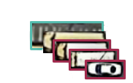
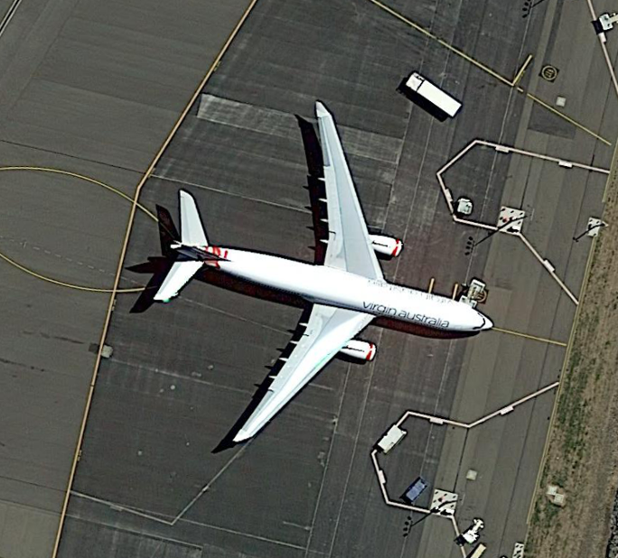
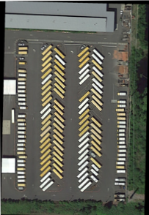
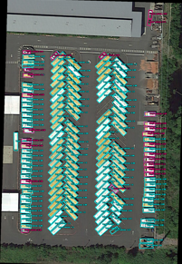
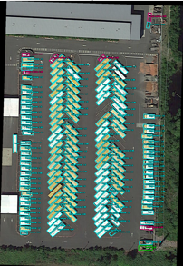
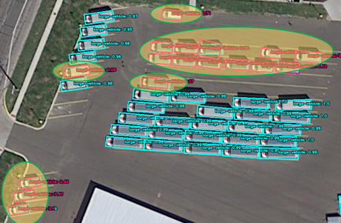
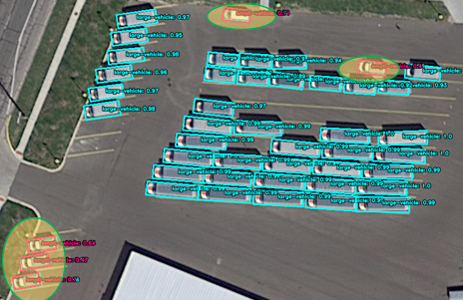
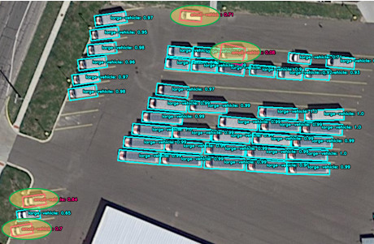
Reducing Confusion in Aerial Image Oriented Object Detection via Bounding Box Consolidation
Trương Thành Thắng^{1,3}
Ngô Văn Tấn Lưu ^{2,3}
{¹20521907, ²20521591}@gm.uit.edu.vn
³University of Information Technology, Ho Chi Minh City, Vietnam
What ?
Why ?
We summarize our contributions in this research as:
The Aerial image is a key tool for a wide range of applications, including disaster response, urban planning. However, detecting objects in aerial images can be challenging, as objects may appear at different angles and orientations, and multiple objects may appear in close proximity to one another. One common problem in aerial image object detection is the assignment of multiple bounding boxes to the same object, with only one of those bounding boxes labeled correctly. This can lead to confusion and inaccuracies in the results e.g. counting, which can have significant implications for real-world applications.
Build a 2-phase pipeline that can flexibly change the oriented object detector and the classifier to reduce bounding box confusion in the object detection problem from the aerial image.
Survey of S2ANet, R3Det, ReDet, Oriented RCNN, RoI Transformer models as detector and EfficientNet as classifier on DOTA datasets.
Overview
Oriented Object Detection Problem
Issue
R3Det
RoI Transformer
ReDet
S2ANet
Oriented R-CNN
INPUT
MODEL
OUTPUT
An aerial image
A trained oriented object detector
An image contains oriented bounding box
Description
1. Two accessible solutions
2. Our Pipeline
Sifting
ClsNet
helicopter – 0.03
roundabout – 0.31
plane - 0.9
plane - 0.9
Multi-class Non-maximum Suppression
OrientedNet
helicopter – 0.03
helicopter – 0.03
roundabout – 0.31
roundabout – 0.31
plane - 0.9
Our pipeline consists of 2 phase:
plane - 0.9
plane - 0.9
Phase 1: Input an aerial image through an oriented object detector returns oriented bounding boxes.
Restrictions: The orange circled area is where there are still multiple bounding boxes on the same instance.
Phase 2: Extract the oriented bounding boxes from phase 1 into the classifier for relabeling. Then, the outputs from both the oriented object detector and classifier are combined, and non-maximum suppression is applied to eliminate redundant or incorrect bounding box.
Finally, we made changes to the oriented object detectors S2ANet, R3Det, RoI Transformer, Oriented RCNN, ReDet and monitored the effectiveness of our pipeline on the final result.
Original
Sifting
Multi-class NMS
Trương Thành Thắng – University of Information Technology
TEL : 0979297624 Email : 20521907@gm.uit.edu.vn
Notes:
1

